Slide 1




Champion
KV Reasons to believe
1 | Confidential

Slide 2

Champion KV
Summary
Executive Summary
Challenge
Research & Results
KV
Working on PHB
for over one year
Challenges
to overcome
Blend & Research
led solution
Establishing KV
emphasize RTBs
Working to comply with PHB guidelines, including the full ban on flavours and additives, along with many other changes.
As a result of the PHB changes the brand has encountered challenges.
A combination of insight and research has guided us in identifying the core reason to believe.
The key visual has been created to support the reason to believe.
2 | Confidential

Slide 3

Challenge
Challenge
Research & Results
KV
3 | Confidential

Slide 4


Champion KV
Challenge
Challenge
Challenge
Research & Results
KV
The Objective
The Challenge
Identify Portfolio Risk
Ensure consumer preference / targeted alternatives are made available to maximise retention
Ensure portfolio compliance & reassess new portfolio
Flavours & Additives Ban
No sugar (or a substitute) or flavour (whiskey/rum, etc)
What Was Done To Meet The Objective?
Execution
GPIT completed Oct 23
Acceptance + research planned for Jan 24
Develop & test blends to migrate consumers from current brands at risk
4 | Confidential

Slide 5
Champion KV
Challenge
Champion Current Context
Challenge
Research & Results
KV
Champion is a key contributor of IBA share and profit; Equity is lower than Winfield
National Share
Profitability
Equity is comparable to Port Royal but lower than Winfield
Primary leakage to 4th Tier
Top 3 INS
Top 3 OUTS
12.52%
12.76%
1
Winfield Reg
1
Choice
Capstan
Riverstone
FY23
FY23 Jul LE
2
2
12.52%
12.76%
3
Bond Street
3
P&S
Nearly one-third of RYO smokers are not aware of Champion
Conversion rates are lower than Winfield
5 | Confidential

Slide 6

Research & Results
Challenge
Research & Results
KV
6 | Confidential

Slide 7
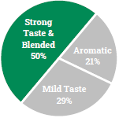
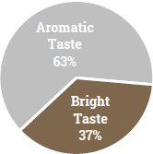
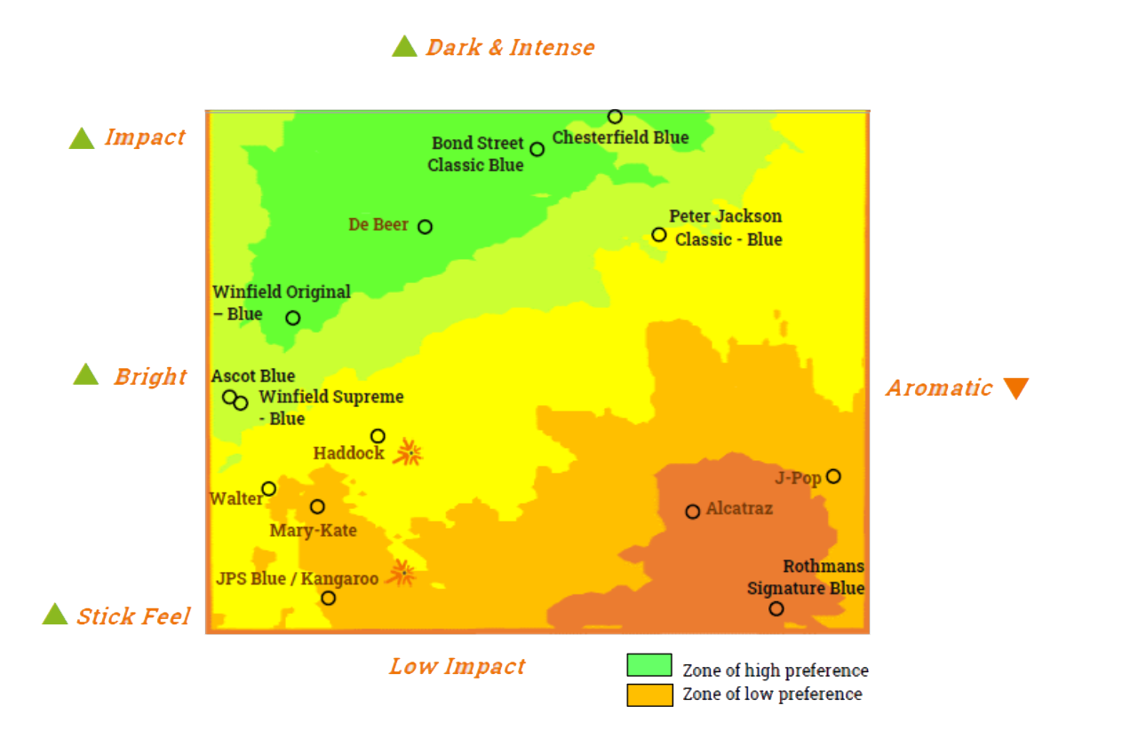
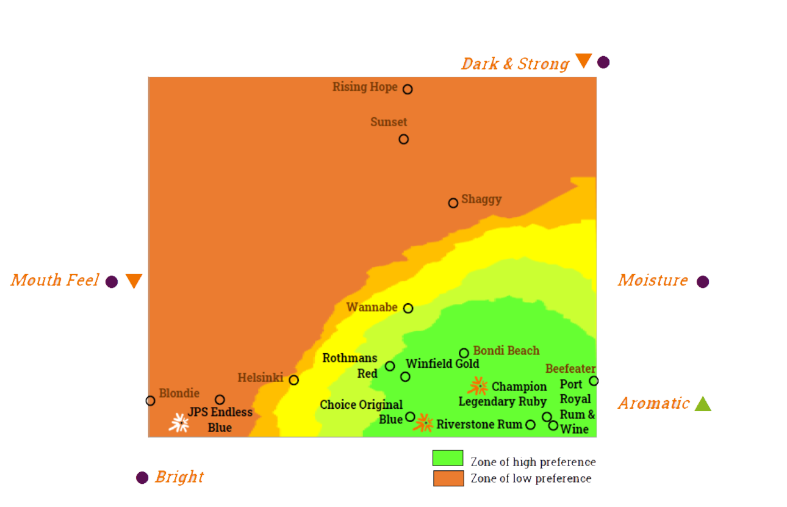

Champion KV
Research & Results
Unbranded sensory blend mapping
Challenge
Research & Results
KV
Objectives
FMC
FCT
To develop sensory maps for the FMC and FCT categories in Australia which highlight opportunities for new product launches.
Full Strength tasting: Most liked brands: Ascot Blue, Horizon Red
GPIT: 3 ‘Full strength’ taste segments discovered. Best IBA brand for each segment identified
Most liked brands: Riverstone Rum, Port Royal and Champion Ruby. Bondi Beach also performs strongly
GPIT: 2 segments identified
Bondi Beach performs strongly
Methodology
2 Stage Approach
1
Home Use Test. Respondents evaluate up to 16 products Categories evaluated: Full strength tasting FMC, Low strength tasting FMC and FCT
GPIT sensory panel evaluated the products to develop sensory maps
2
7 | Confidential

Slide 8



Champion KV
Research & Results
Unbranded sensory blend mapping
Challenge
Research & Results
KV
Use of non-flavoured tobacco
Champion main users (Champion Ruby: After Smoking)
92%
Claim they will choose the new blend
Yes, I would use it from time to time, but I would look for alternatives
Yes, I would use a non-flavoured tobacco as it is
23%
69%
8%
No, I would change to another format /product / stop smoking etc.
92% of current Champion Ruby main branders would use non-flavoured tobacco instead of changing to another format/product or stop smoking, most of them would use a non-flavoured tobacco as it is.
Source: Quantitative Research FCT Australia (NTS25)
Would you use a non-flavoured tobacco such as the ones you tested or would you would change to another format / product / stop smoking etc.? If you do not want to use non-flavoured tobacco, which of the following would you do?
8 | Confidential

Slide 9




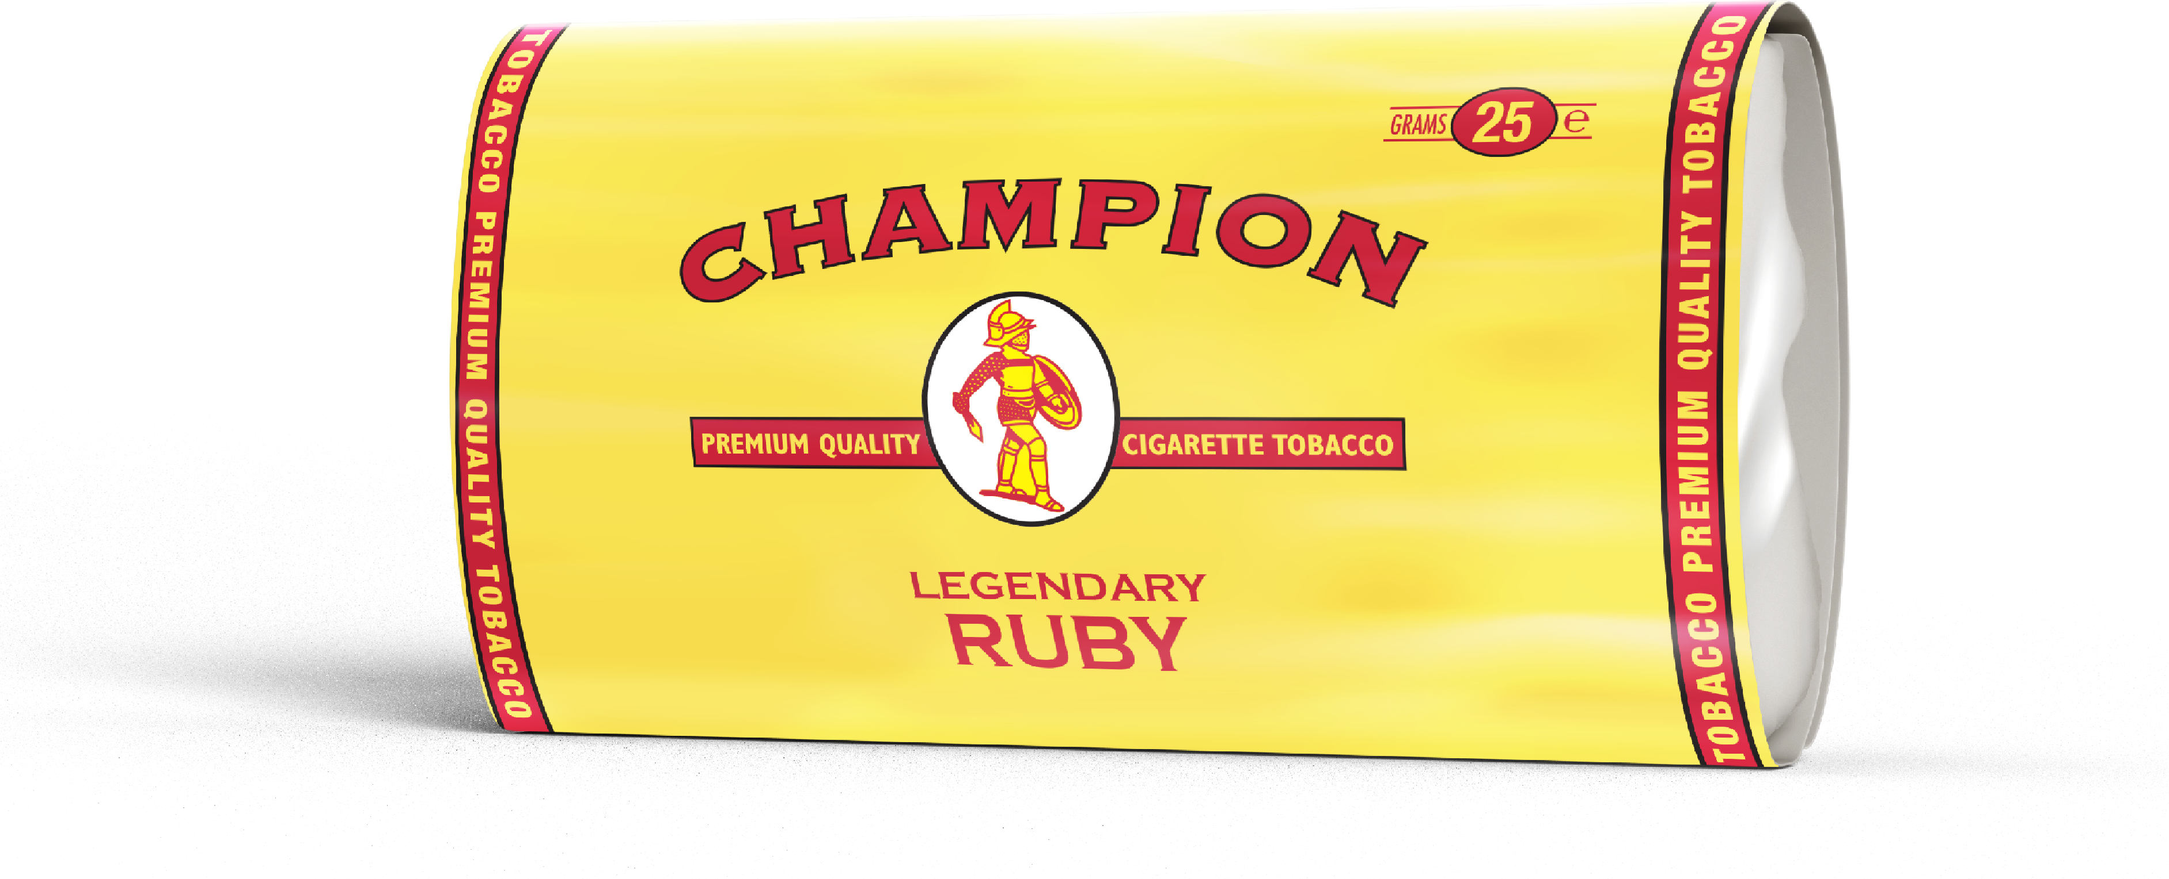
Champion KV
RTB: Quality
Rationale for RTB: Quality
Challenge
Research & Results
KV
Brand Positioning & Functional Benefits
Portfolio Strategy ahead of NTS
Establishing the RTB
Brand Positioning:
A trusted brand with rich Australian heritage, Champion provides smokers with a quality experience (flavour & aroma) that’s worth the price​
The headline strategy for Champion ahead of NTS was to be the destination for the disrupted specialist brand smokers – a trusted brand, with quality tobacco (best new product) and experience.
After segmenting tastes preference and understanding Champion consumers' preferred blend, we focused on the new Champion blend, identifying its USP that align with Champion's quality image.
Hence the RTB:
Quality tobacco with a distinctive taste and pleasant aroma that creates a unique smoking experience.
Hand picked & hand stripped yields a high-quality connotation which aligns with quality tobacco.
A trusted brand
For specialist smokers
A great experience
Brand Equity Snapshot, Champion
Hand picked & hand stripped tobaccos
Functional Benefits
9 | Confidential

Slide 10

Key Visual
Challenge
Research & Results
KV
10 | Confidential

Slide 11
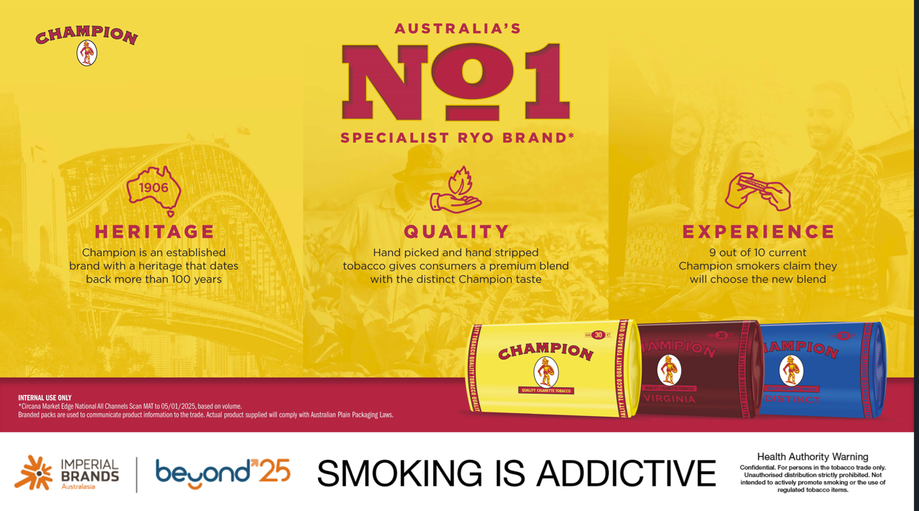
Champion KV
KV
Key Visual
Challenge
Research & Results
KV
9 out of 10 current Champion smokers claim they will choose the new blend
11 | Confidential

